Slide 1
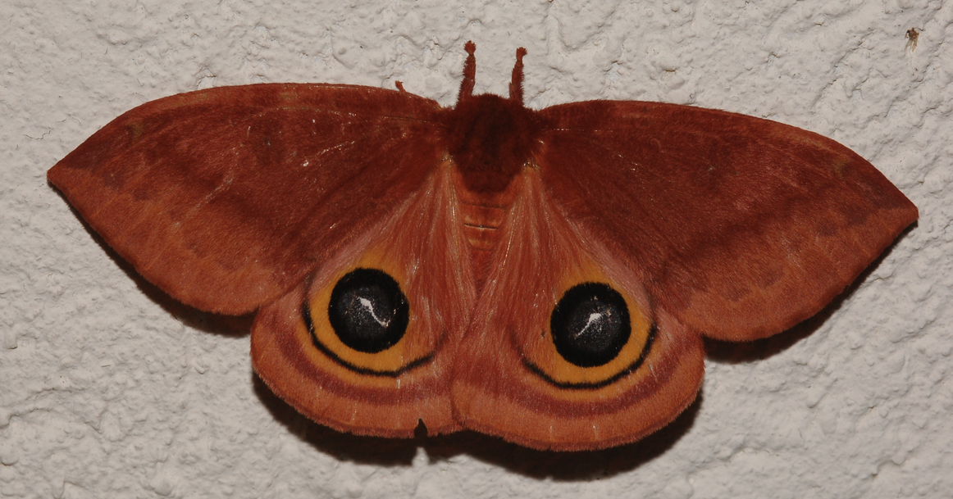
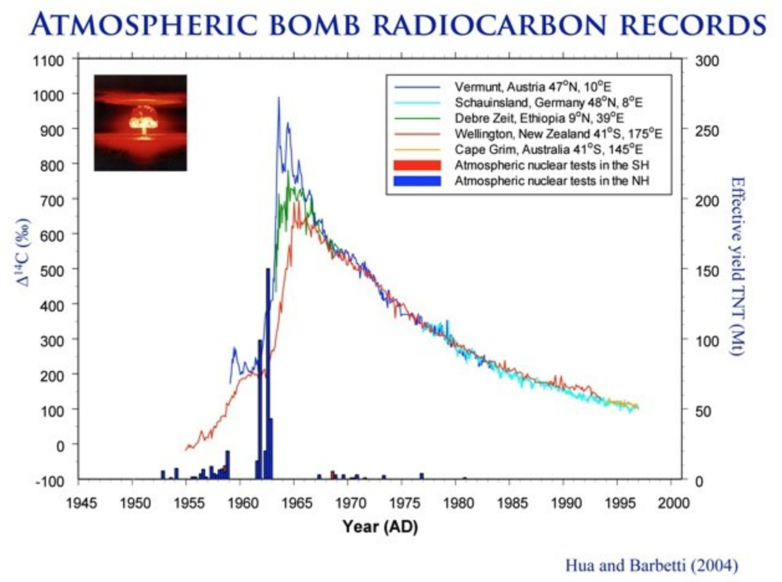
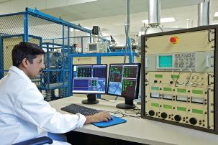
Novel use of ¹⁴C bomb-pulse to measure how many years saturniidae moths spend as pupae John Pickering and Alex Cherkinsky University of Georgia, Athens, Georgia, USA

Slide 2
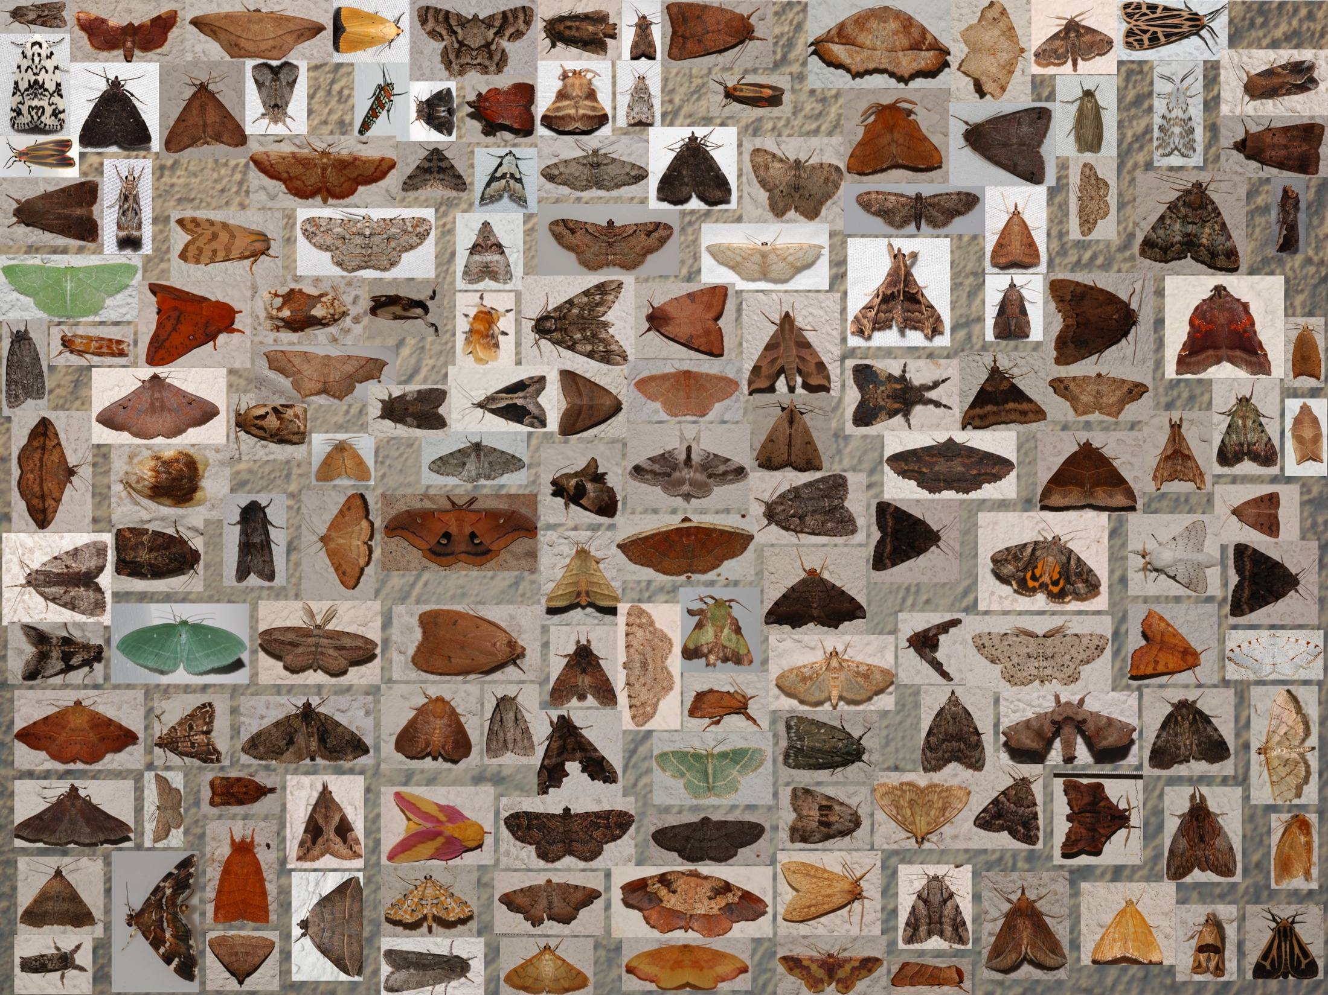

Slide 3
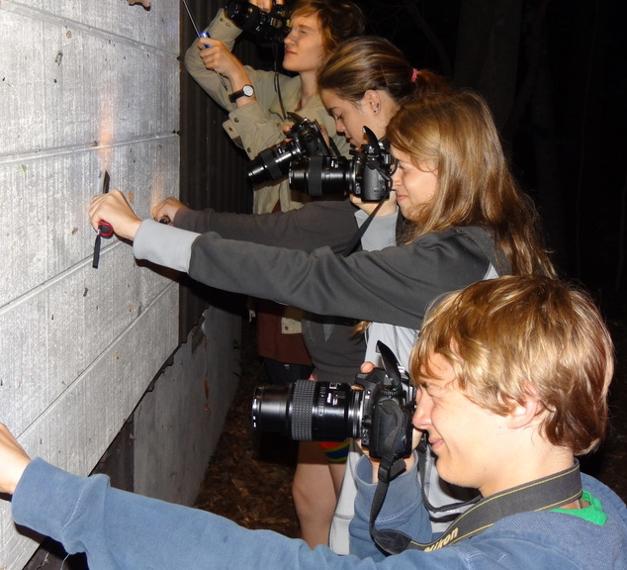

Slide 4
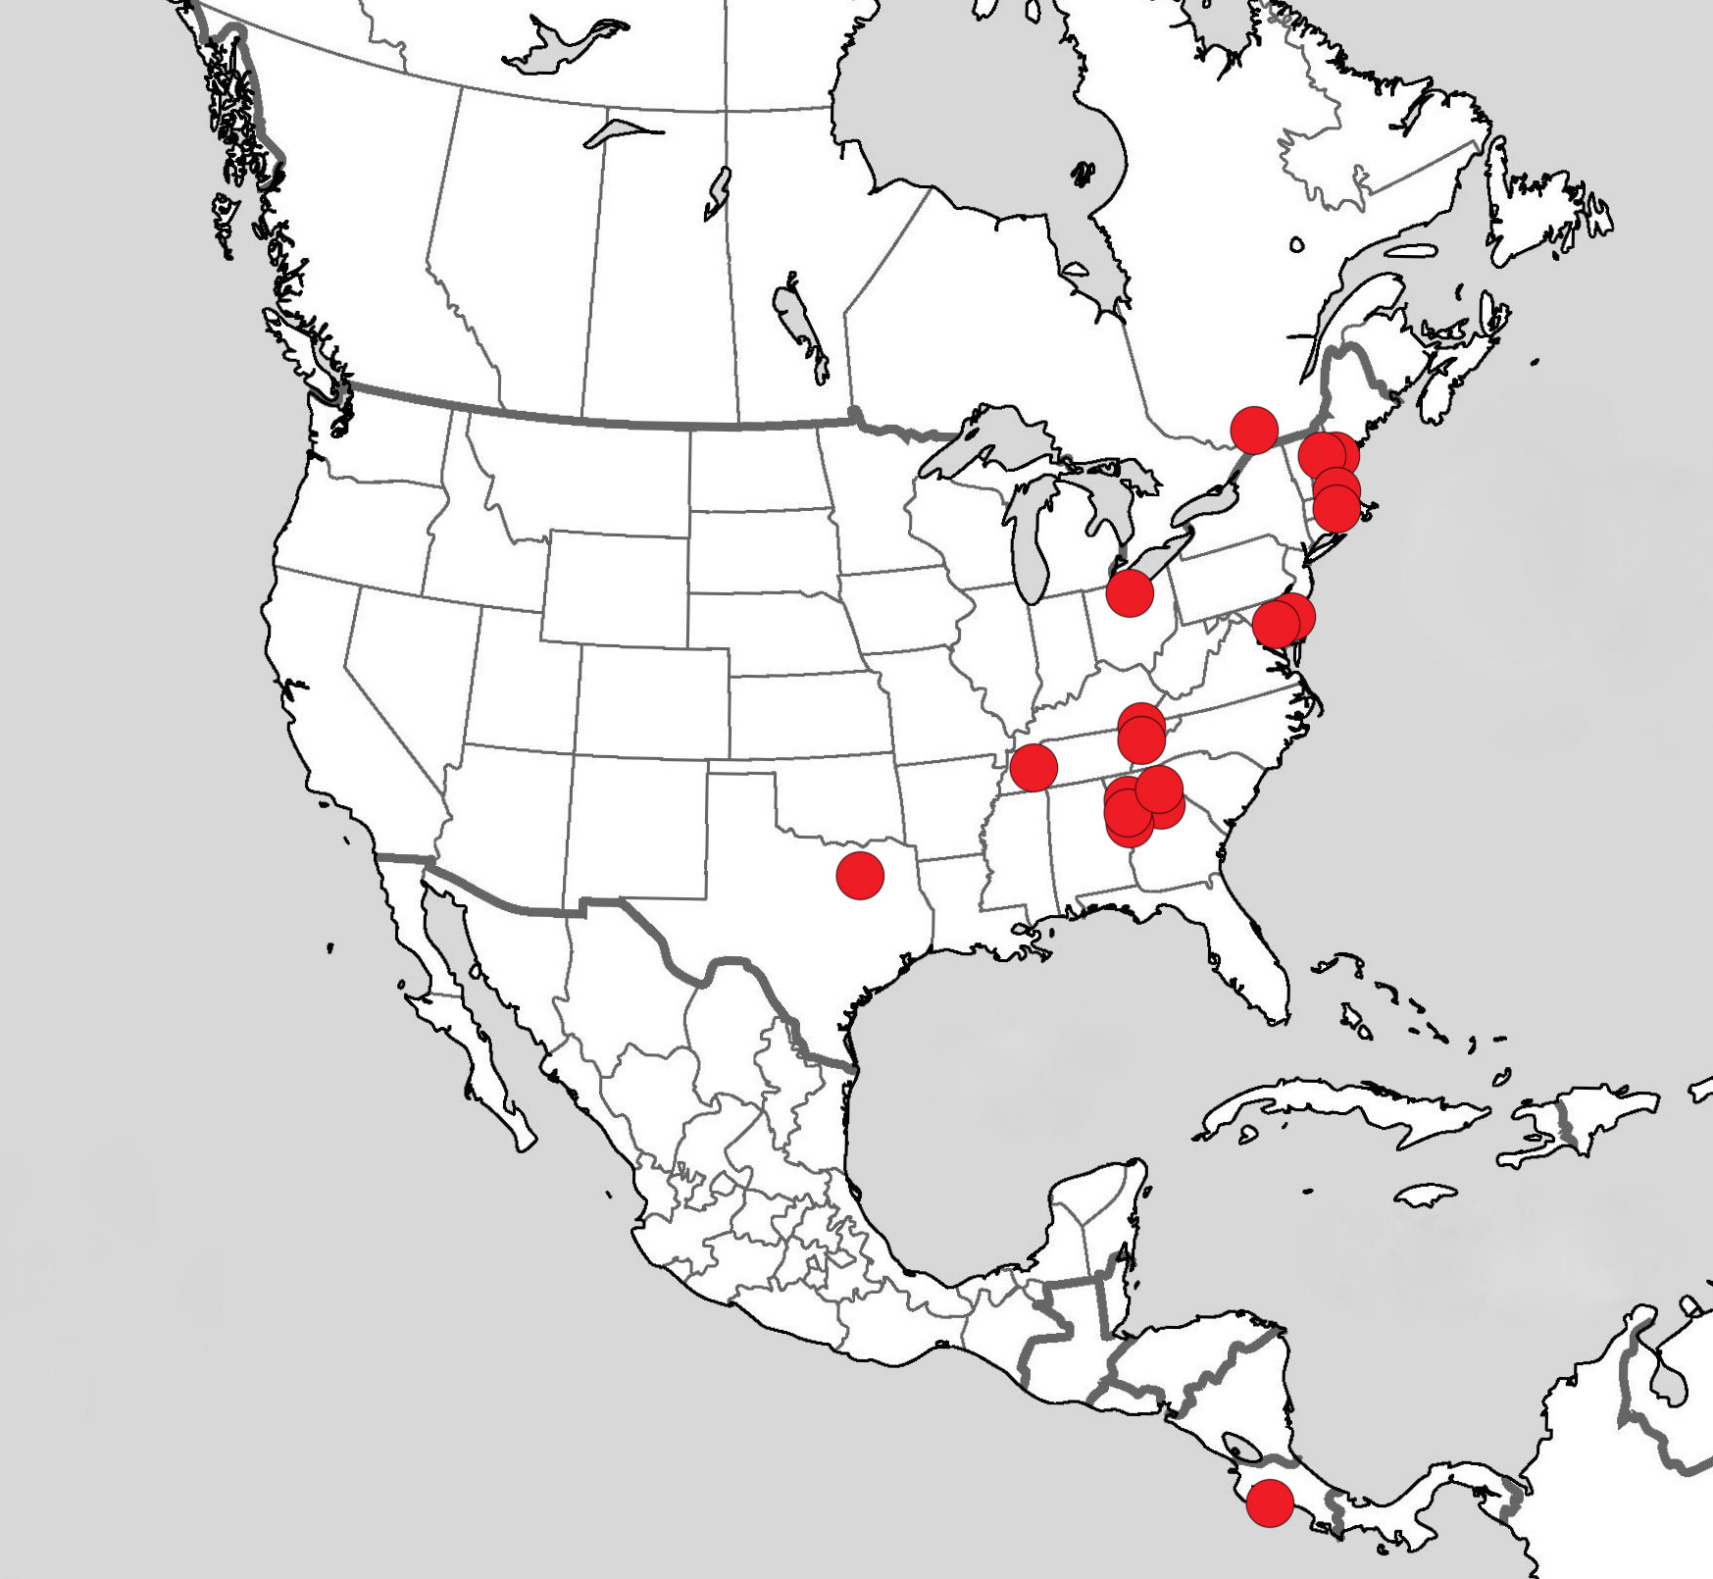

Slide 5
Life cycle
Pupa
Adult
Egg
Larva

Slide 6
Pupa banks

Slide 10
Synchronized flight pattern

Slide 11
Dryocampa rubicunda [Saturniidae] Rosy Maple Moth

Slide 12
Complex flight pattern

Slide 15
Moth families
Saturniidae – Silk moths -- Adults do not feed
Sphingidae – Hawk moths – Adults feed

Slide 17
Bomb-pulse radiocarbon dating

Slide 19
Automeris io, Io Moth

Slide 21
Calibration of 1.362000±0.002600 with NHZ2, intcal13.f14c,
24931(36)
OneSigma
[cal AD 1962.50 :cal AD 1962.64]0.117
[cal AD 1974.94 :cal AD 1975.26]0.118 1975.83±0.89
[cal AD 1975.98 :cal AD 1976.71]0.765
TwoSigma
[cal AD 1962.38 :cal AD 1962.70]0.125
[cal AD 1974.84 :cal AD 1976.98]0.855 1976.73±1.89
[cal AD 1977.46 :cal AD 1977.56]0.019 1976.20±1.36
[cal AD 1978.61 :cal AD 1978.62]0.001

Slide 23
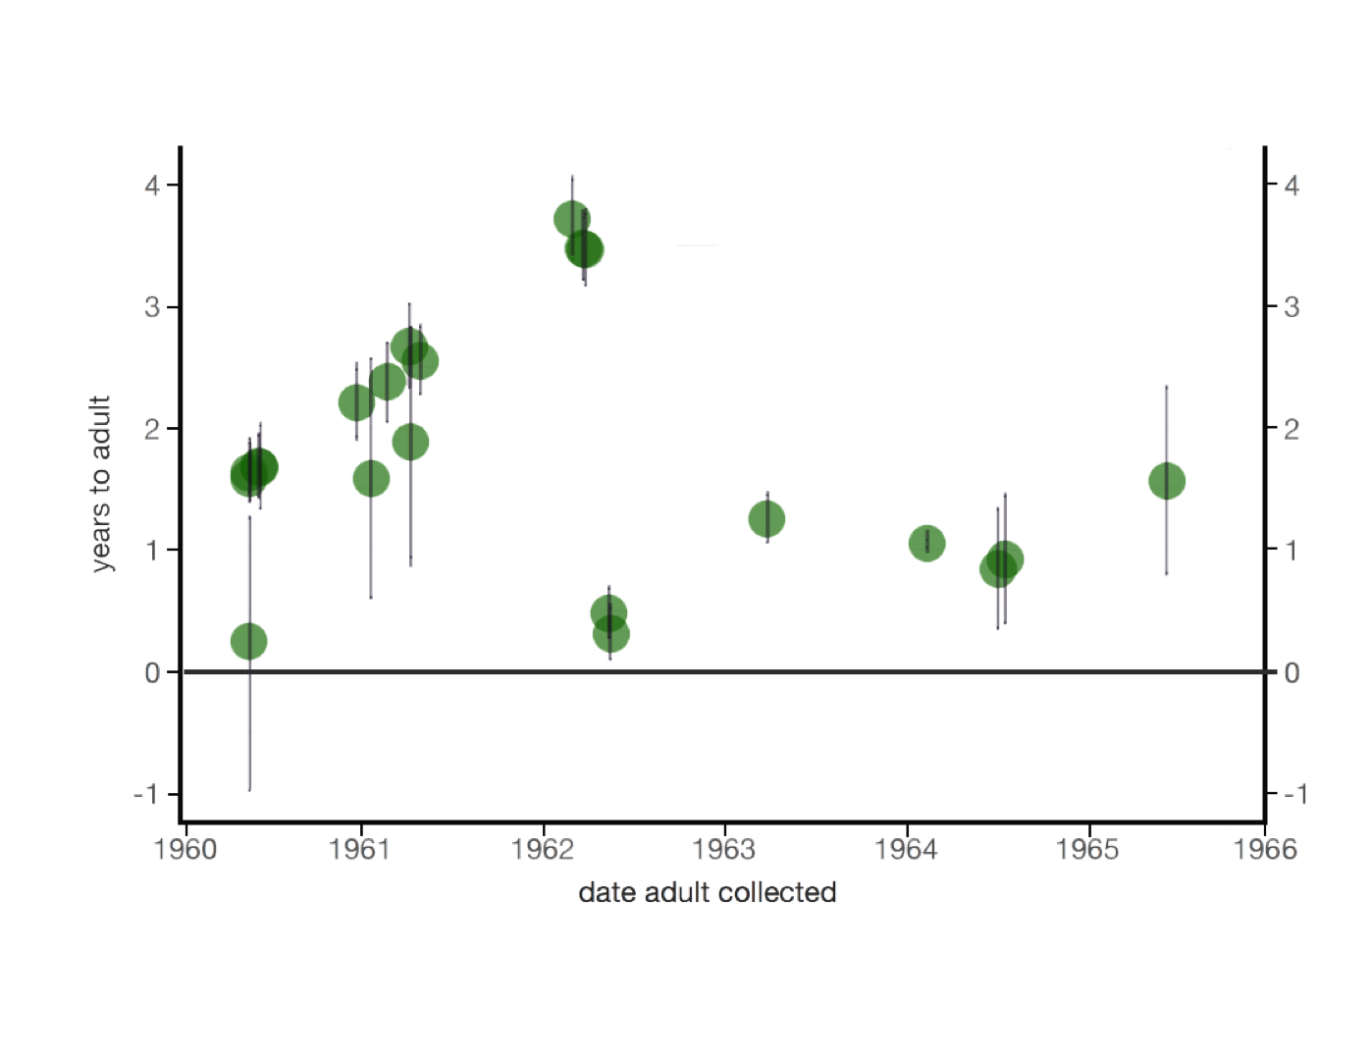

Slide 24
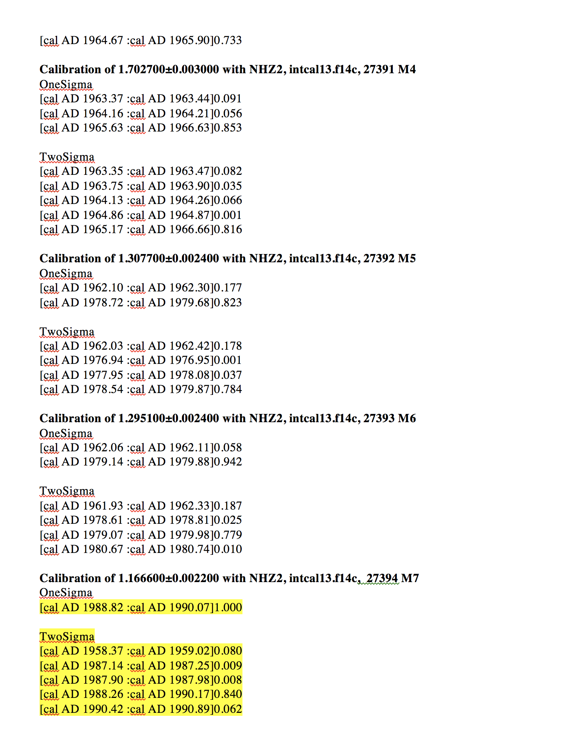

Slide 26
Models of insect population dynamics

Slide 27
Summary and perspectives for the future research
At the first time was applied 14C measurements to define the delay in pupa stage of the moths
There were analyzed the feed and do not feed moths from collection of the end of 1970s –beginning of 1980s. It was shown that the fed adult moths could not be used for this kind of study because they consume the contemporary carbon.
The study has shown that about 25-30% of the moth pupas were delayed at least for 1-3 years and some of them possible to 10-15 years.
Given our method success, we now plan to analyze more specimens to measure how frequent super diapause is across natural populations and how it may be affected by geographical location and oscillation of the weather pattern.
THANKS

Slide 28



